Slide 1

LogicX - YieldGuard
S1 Wafer Yield Root Cause & Defect Pattern Analyser

Slide 2

The Problem
Leading-edge fabs repeatedly process lots through hundreds of tightly controlled steps. When yield declines, evidence is distributed across equipment, recipes, and metrology.
Manual analysis is slow and often misses spatial defect signatures and critical parameter interactions that cause significant yield loss.

Slide 3




The YieldGuard Solution
Detect
Rank
Action
Monitor yield excursions with robust rolling baselines, tracking active process drifts instantly.
Score root causes by temporal alignment, tool concentration, and yield effect size securely.
Generate approval-ready corrective action records without unsafe autonomous equipment control.

Slide 4

Real-Industry Data Model
Genealogy & Equipment
Metrology & Defects
Tracks wafer routing contexts, tool states, alarms, and specific process sensor variables (e.g., chamber pressure, RF power, gas flows) across distributed modules.
Consolidates measurement proxies, inspection images, target specs, and high-resolution spatial coordinates necessary for downstream yield mapping and pattern extraction.

Slide 5

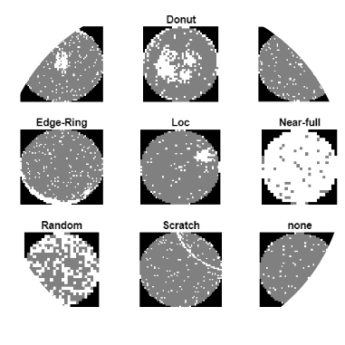
Wafer Pattern Lab
Interactive Spatial Signatures
YieldGuard utilizes an interactive circular map employing x/y defect coordinates. It dynamically identifies prototype spatial signatures—such as center-heavy clusters, edge rings, and localized hotspots.
Engineers can compare defect densities between good and bad lots visually to trace physical manufacturing anomalies.

Slide 6
Root Cause Evidence
100%
No Black-Box Probabilities
YieldGuard rejects raw LLM guesses. Instead, it relies on transparent, configurable composite scoring. Every AI-derived metric includes underlying evidence counts, data-quality badges, and validation history to ensure complete engineering trust in root-cause candidate selection.
Transparent Scoring

Slide 7


The Investigation Workflow
Quality Gate: Schema validation and lineage verification ensures pristine data quality before any statistical analysis begins.
Control Tower: Yield excursion alerts trigger on statistical deviations identifying active process drifts across lots.
Parameter Panels: Detailed views display out-of-control states, enabling clear before-and-after baseline comparisons.
CAPA Actions: Actionable recommendations explicitly state the underlying evidence, required owner, and distinct acceptance criteria.

Slide 8
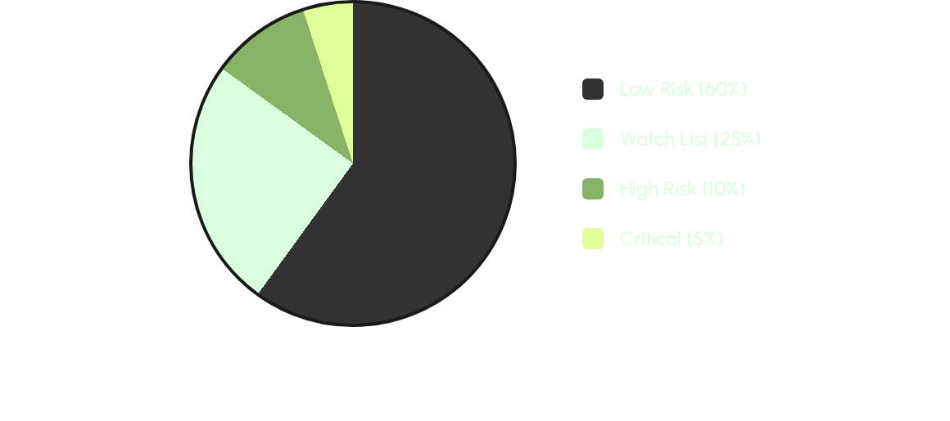
Pre-Run Lot Risk Profiling
The predictive model flags upcoming lots before they incur yield losses, comparing current process states against historical analog lots to assign a comprehensive risk band.

Slide 9
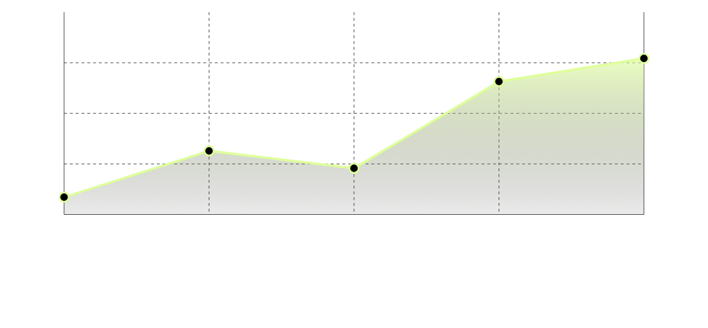
Demonstrating Business Impact
Cost-impact panels utilize configurable assumptions (wafers per lot, value per die) to estimate exposure, demonstrating a significant reduction in prevented loss over time.

Slide 10
The Decision Loop
Real Fab Data ➔ Trustworthy Evidence ➔ Actionable Decision

Slide 11


Image Sources
https://www.universitywafer.com/img/semiconductor-cleanroom-wafer-processing.webp
Source: www.universitywafer.com
https://ch.mathworks.com/help/examples/images_deeplearning/win64/ClassifyWaferMapDefectsUsingDeepLearningExample_01.png
Source: www.mathworks.com

